Slide 1
Introduction to digital video technology
Notes:
Present yourself, general overview about video encoding
What, Why, How

Slide 2
Feedbacks
Please take notes about possible improvements.
Feedback are welcome, things like: better naming, shorten Y content, expand X content and etc.
Don’t let the others suffer as you will.
Notes:
Speak about github repo: https://github.com/leandromoreira/digital_video_introduction
Please give me feedback, I’ll be so happy.
It can be boring at the first for someone who knows more about computer and mostly for those who are avid in audio and video but bear with me, we’ll reach a point where you can also benefit from it.
Designers will be angry with my slides design, fine art!

Slide 3
Basic Terminology

Slide 4
What is an image?
R
G
100
0
0
0
B
100
7
0
0
0
100
7
2
0
0
0
100
100
2
2
2
2
100
100
6
0
0
2D
100
6
6
6
3D
color intensity
Notes:
We can simply see an image as an 2d array of integers, if it’s gray color but if it’s color it’ll use more planes what makes it a 3d array

Slide 5
What is picture element (pixel) ?
R
100
0
0
0
G
100
7
0
0
0
B
100
7
2
0
0
0
100
100
2
2
2
2
100
100
6
0
0
100
6
6
6
Notes:
is a physical point in a raster image, or the smallest addressable element in an all points addressable display device; so it is the smallest controllable element of a picture represented on the screen.

Slide 6
What is bit (color) depth?
R
100
0
0
0
G
the range
100
7
0
0
0
B
0-255
8R+8G+8B = 24 bits
100
7
2
0
0
0
100
100
2
2
2
2
100
100
6
0
0
100
6
6
6
*it gives you 2^24 different colors
Notes:
the number of bits used to indicate the color of a single pixel

Slide 7



Color depth
24 bpp
10 bpp
8 bpp

Slide 8
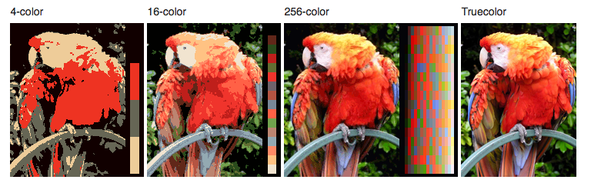
Color depth

Slide 9

All colors from RGB
X
Notes:
Some might think of rgb color formation as like in paint but isn't all the colors blend to white? Why is it brown here?
That's not the right model. This is Subtractive color model

Slide 10
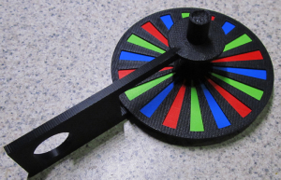
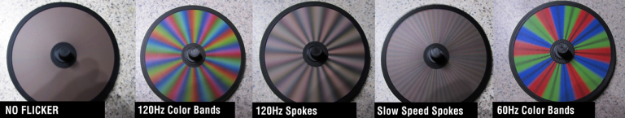
All colors from RGB
https://lumeniquessl.com/2012/03/01/12-in-12-for-2012-the-flicker-indicator-machine/
Notes:
If you think about the frequency (speed) we see the color (band) we'll have a better approximation
This is additive color model
DEMO Spinning color wheel white experiment
https://www.youtube.com/watch?v=7iV1m4j2wJQ

Slide 11
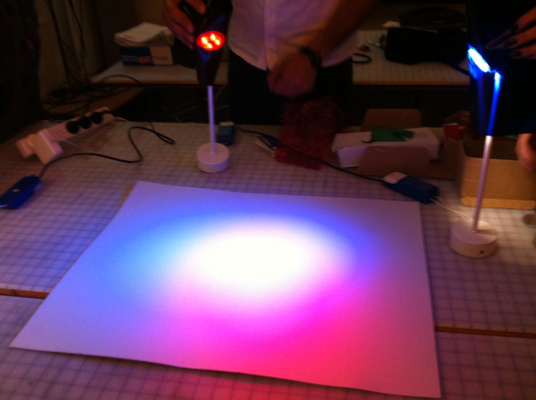
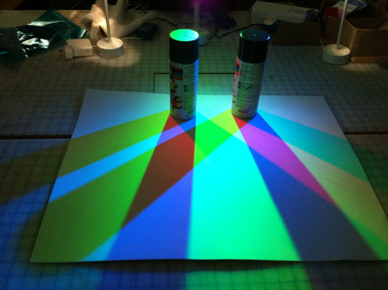
All colors from RGB
https://lightingstudio.wordpress.com/2012/03/27/week5-light-object-shadow-contrast/
Notes:
Think of light, if you turn on red, green and blue and point them to a center, you'll see a white light :D
And if you block some of the light you'll see formation of other colors.

Slide 12
What is resolution?
width
4
height
4
Notes:
DEMO TIME image_as_3d_array.ipynb and how_filters_work.ipynb
is the number of distinct pixels in each dimension that can be displayed. It is usually quoted as width × height, with the units in pixels.

Slide 13
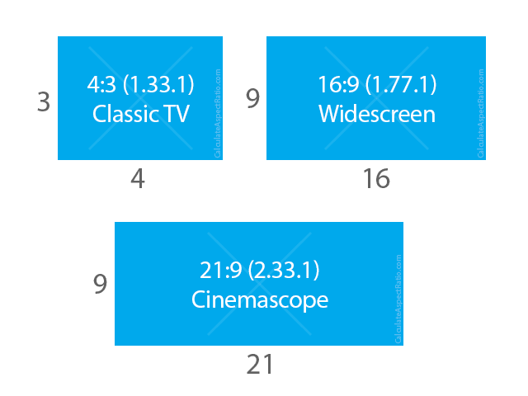
What is display aspect ratio (DAR)?
16:9 (1.7777777778) 4:3 (1.3333333333)
1280/720 (1.7777777778) 1024/768 (1.3333333333)
Notes:
describes the proportional relationship between its width and its height

Slide 14


What is pixel aspect ratio (PAR)?
PAR 1:1
PAR 2:1
Notes:
is a mathematical ratio that describes how the width of a pixel in a digital image compares to the height of that pixel.

Slide 15
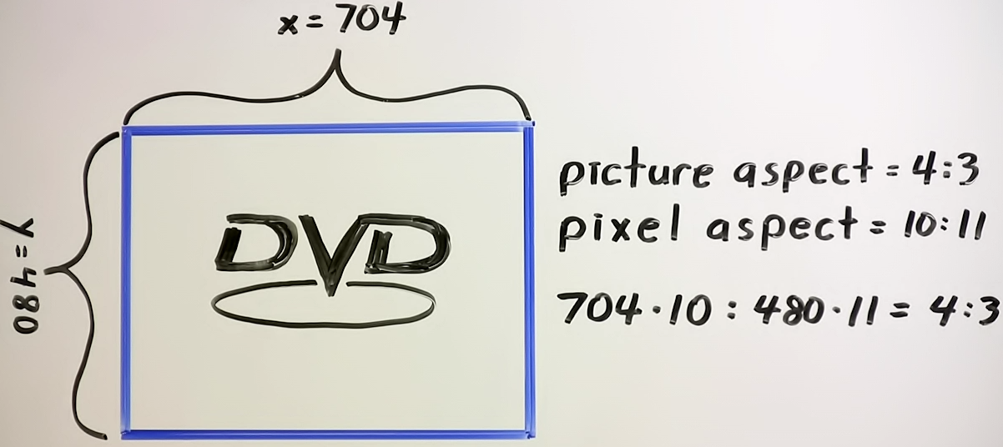
DVD display aspect 4:3, pixel aspect: 10:11
Source https://xiph.org/video/vid1.shtml
Notes:
SAR storage aspect ratio

Slide 16
What is a video?
time
a single frame
30 frames per sec (FPS)
framerate
4D
Notes:
is a representation of moving visual images in the form of encoded digital data. It gets another dimension, time, what makes it a 4d signal.
Talk about different frame rate 30 29.97 24 23.99 (Hz)
http://theautomaticfilmmaker.com/blog/2009/2/23/about-frame-rates-or-why-2997.html
https://www.youtube.com/watch?v=yniSnYtkrwQ

Slide 17
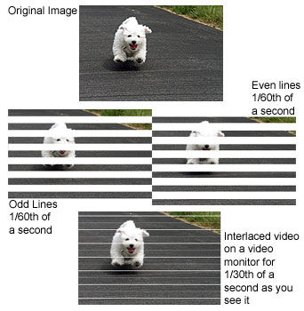
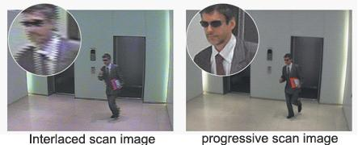
Interlaced | progressive
Notes:
is a technique for doubling the perceived frame rate of a video display without consuming extra bandwidth.
Deinterlacing is the process of converting interlaced video, such as common analog television signals or 1080i format HDTV signals, into a non-interlaced form.
Progressive is a way of displaying, storing, or transmitting moving images in which all the lines of each frame are drawn in sequence.

Slide 18
What are 480p, 1080i, 1080p formats?
[number][letter]
number is the resolution's height and letter: p means progressive and i means interlaced.

Slide 19
What is bitrate?
WIDTH * HEIGHT * BITS_PER_PIXEL * FPS
4 * 4 * 24 * 30
11,520 bits per second
30 FPS
Notes:
It is the number of bits that are conveyed or processed per unit of time, in video’s case second.
11.520 kbps

Slide 20
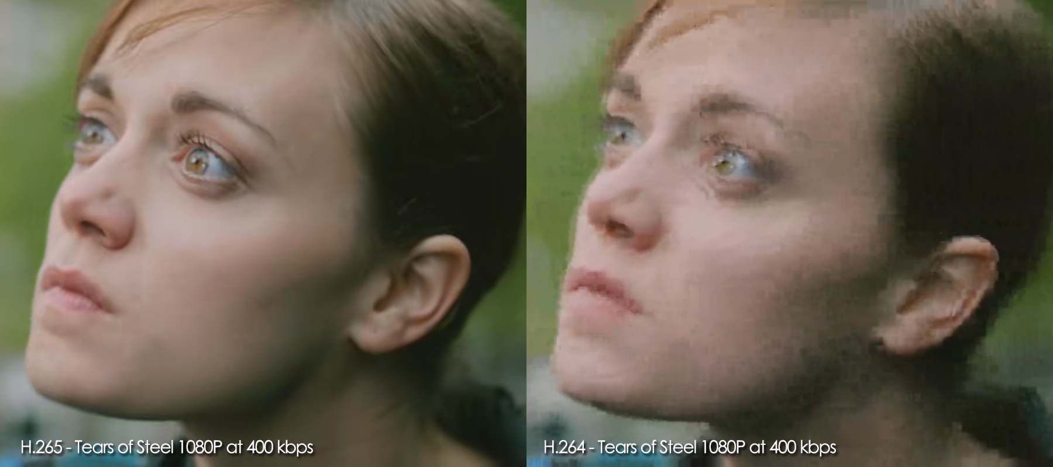
Constant bitrate (CBR)?
1.2Mbps
time
Notes:
means that the rate at which a codec's output data should be consumed is constant. (actually almost constant)

Slide 21
Variable bitrate (VBR)?
2.4Mbps
1.2Mbps
200Kbps
time
Notes:
allows a higher bitrate (and therefore might requires more storage space) to be allocated to the more complex segments of media files while less space is allocated to less complex segments.

Slide 22
Average bitrate (ABR)?
2.4Mbps
1.8Mbps
max
1.2Mbps
400Kbps
min
200Kbps
time
can be seen as constrained VBR
Notes:
Same as VBR but constrained

Slide 23
Space needed to store 1h of video at 720p 30fps
WIDTH * HEIGHT * BITS_PER_PIXEL * FPS
1280 * 720 * 24 * 30
663,552,000 (663.552Mb) bits per second
2,388,787,200,000 (278GB)
* without any compression technique at all.

Slide 24
Review
image, pixel, bit depth, resolution, display aspect ratio, pixel aspect ratio, video, frame rate, interlaced, progressive, bitrate, CBR, VBR, ABR
Notes:
DEMO TIME ./s/mediainfo /files/v/small_bunny_1080p_30fps.mp4
seeing all the studied options

Slide 25
From the world to the bits

Slide 26
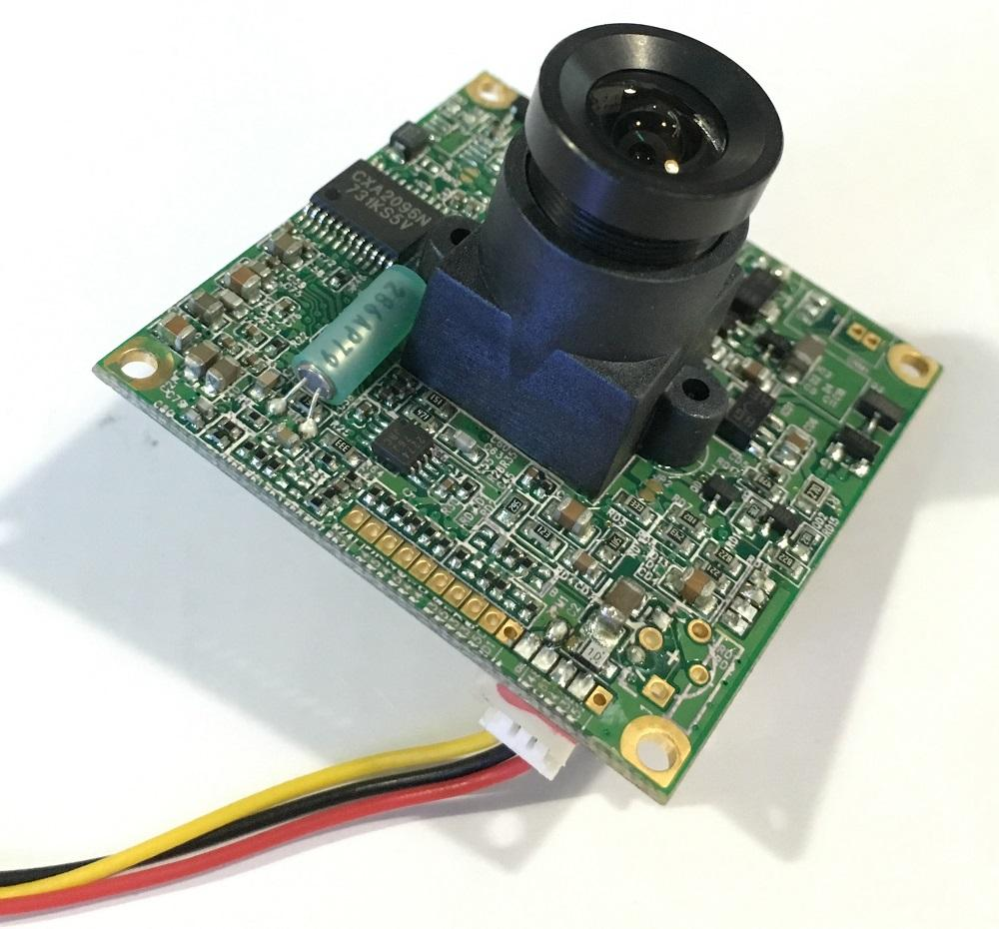
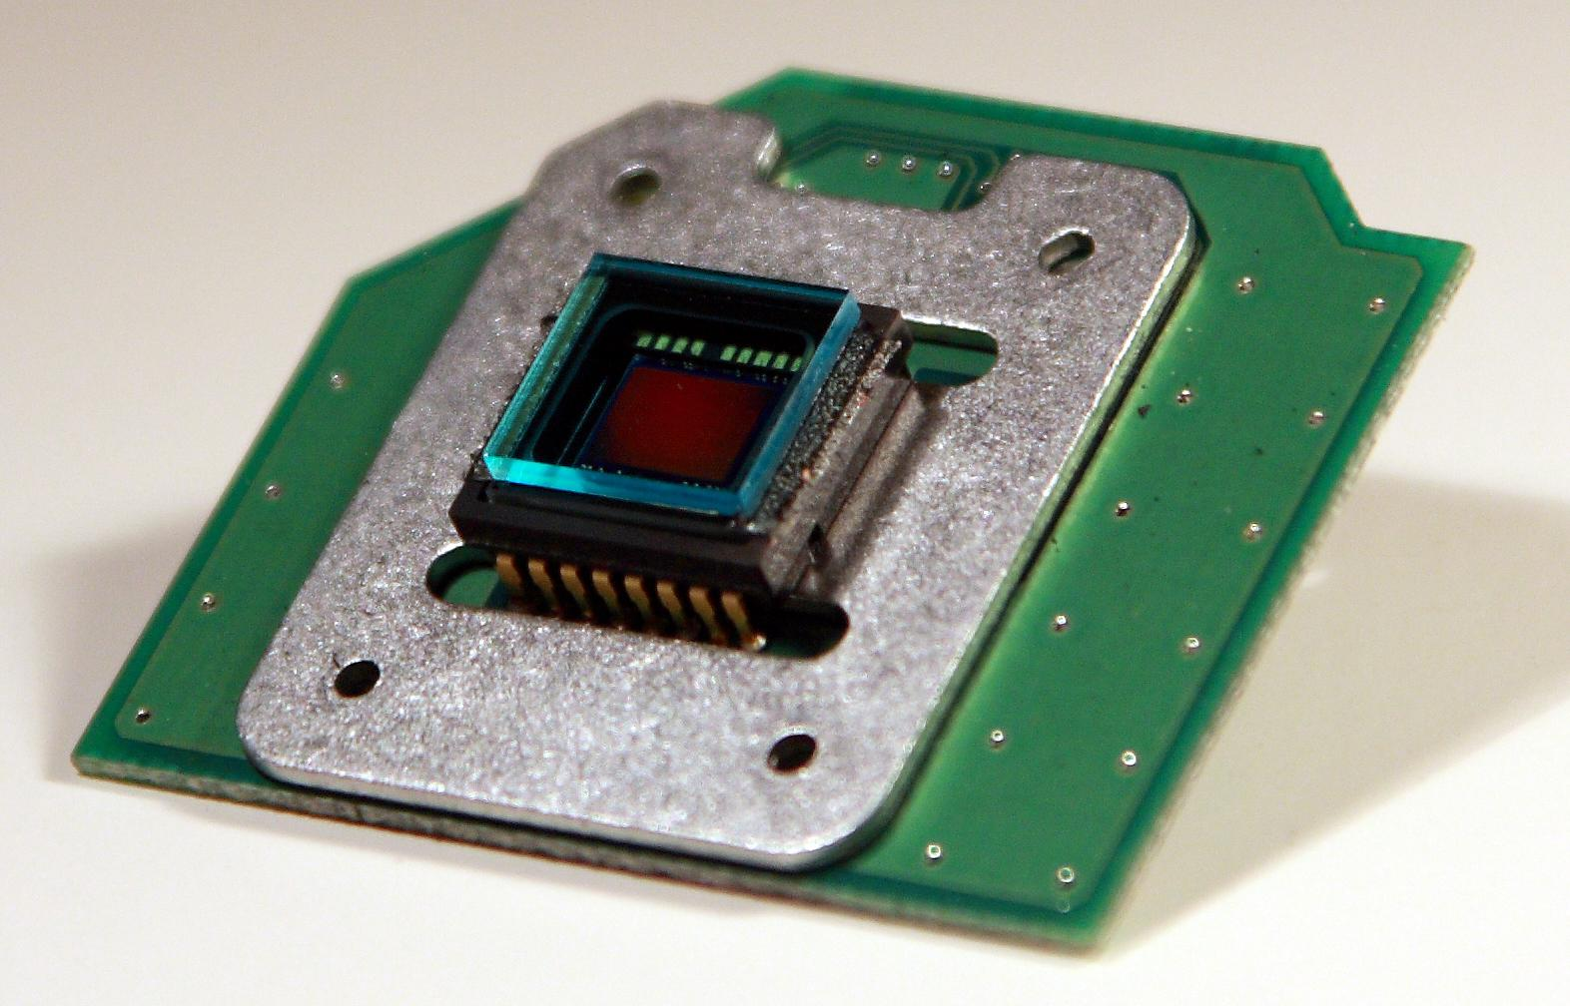
How images are captured? CCD Sensor
Notes:
When you press the button to take a photograph with a digital camera, an aperture opens at the front of the camera and light streams in through the lens and then there is a (photo) sensor which captures the incoming light rays and turns them into electrical signals.
There are basically two devices (sensors) to acquire images: one being CCD

Slide 27
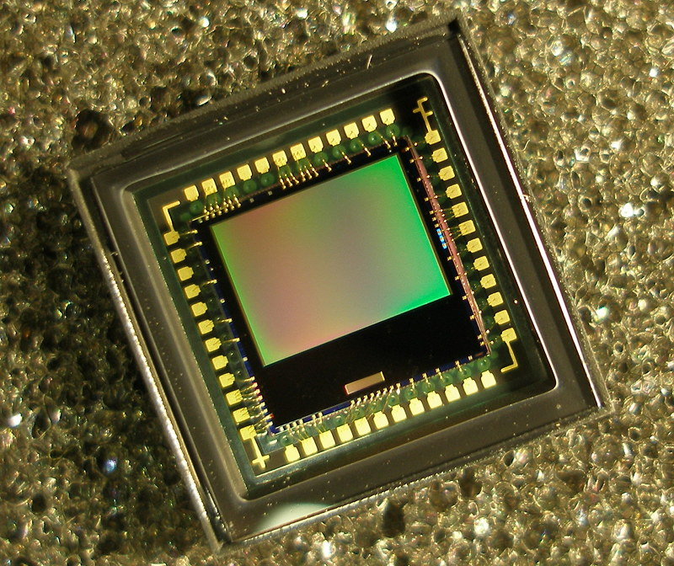
How images are captured? CMOS Sensor (APS)
Use less power
Transmit data faster than CCD
Cheaper
Most commonly in cell phone cameras, web cameras

Slide 28
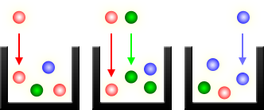
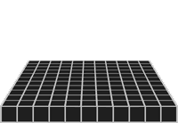
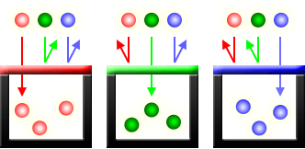
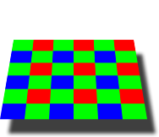
How images are captured?
Sensor
Color filter: Bayer array
Filters 3 primaries colors
Notes:
A digital camera uses an array of millions of tiny light cavities or "photosites" to record an image. When you press your camera's shutter button and the exposure begins, each of these is uncovered to collect and store photons.
However, the above illustration would only create grayscale images
To capture color images, a filter has to be placed over each cavity that permits only particular colors of light.
The most common type of color filter array is called a "Bayer array,"
human eye is more sensitive to green light than both red and blue light

Slide 29

Bayer Demosaicing
Notes:
Bayer demozaikin
What your camera sees

Slide 30
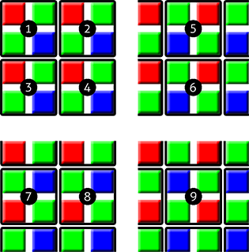
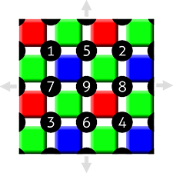

Bayer Demosaicing
Notes:
“Demozaikin”
Bayer "demosaicing" is the process of translating this Bayer array of primary colors into a final image which contains full color information at each pixel.

Slide 31

Bayer Demosaicing

Slide 32
Redundancy Removal

Slide 33

What can we do?
exploit our vision
compress repetitions within the frame
reduce repetitions in time
Notes:
Since it's prohibitive to work with 2.3Tb per video we need to look for solutions.
Correlations in space (point to something and say there are so many correlated colors) and time (it doesn't change that often)

Slide 34
Exploiting our vision

Slide 35
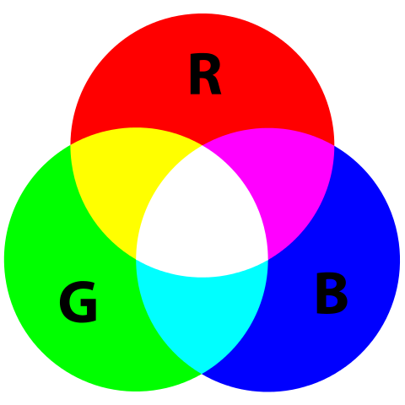
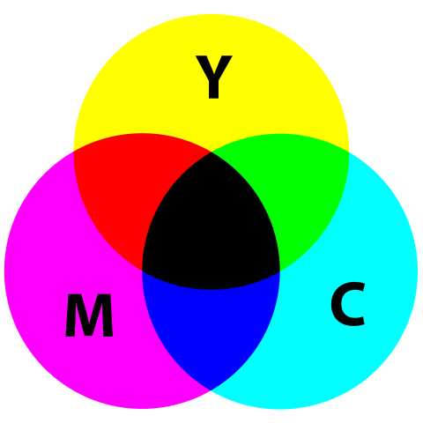
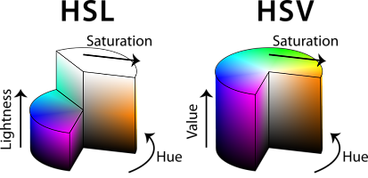
Colors models
Notes:
There are more than one way to represent color models
Secondary color is obtained by mixing it up primary color (cyan magenta yellow)
Color model - show demo, specifically focusing on R G B contribution

Slide 36
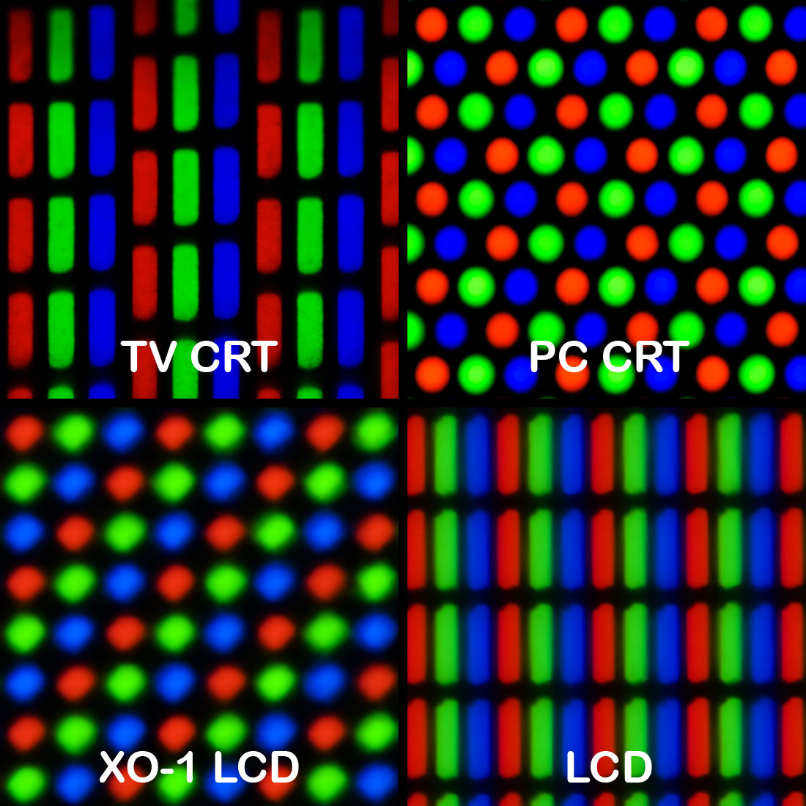
Colors
Notes:
Energy intensity

Slide 37
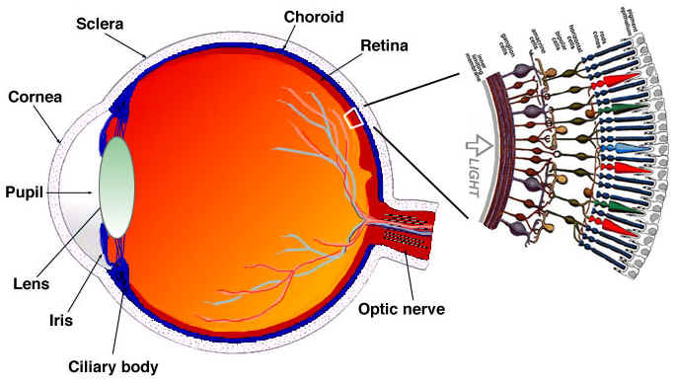
Our eyes - an oversimplification
Notes:
The rod cells are mostly responsible for brightness while the cone cells are responsible for color, there are three types of cones, each with different pigment, namely: S-cones (Blue), M-cones (Green) and L-cones (Red).
Since we have much more rod cells (brightness) than cone cells (color), one can infer that we are more capable of distinguish dark and light than colors.

Slide 38
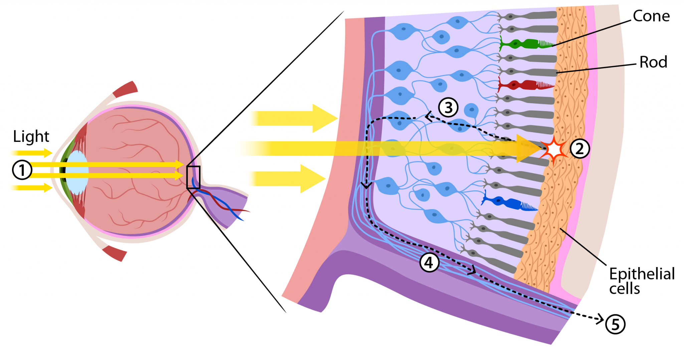
Our eyes - an oversimplification
Notes:
The eye contains about 120 million rod cells and 6 million cone cells.

Slide 39
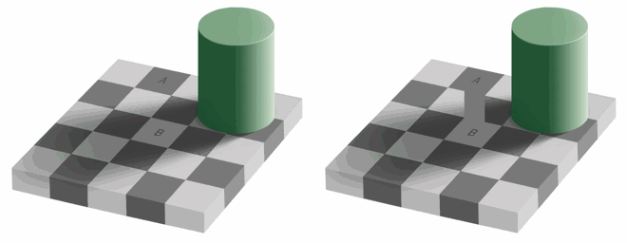
We better to see luma than color

Slide 40

Color space YUV (YCbCr, YPbPr)
Y (luma)
U (chroma blue)
V (chroma red)
Notes:
A color space is a specific organization of colors.
Y′ is the luma component and C_{B} and C_{R} are the blue-difference and red-difference chroma components.
The YCbCr image contains exactly the same information as the RGB image, just in a different representation.

Slide 41
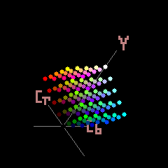

Slide 42
From RGB to YCbCr
Y = 0.299R + 0.587G + 0.114B
C_{b} = 0.564(B - Y) | C_{r} = 0.713(R - Y)
From YCbCr to RGB
R = Y + 1.402C_{r} | B = Y + 1.772C_{b} | G = Y - 0.344C_{b} - 0.714C_{r}
*ITU-R BT.601-7
Notes:
One can ask where is Green?
SD TV definition standard for HDTV the coefficients are others

Slide 43
From RGB to YCbCr
It depends on the recommendation / standards from groups.
Standards | Y (Luma) | Chroma B | Chroma R
SDTV with BT.601 (Rec. 601) | Y=0.299R+0.587G+0.114B | U=0.492(B-Y) | V=0.877(R-Y)
HDTV with BT.709 (Rec. 709) | Y=0.2126R+0.7152G+0.0722B | ... | ...
UHDTV with BT.2020 (Rec. 2020) | Y=0.2627R+0.6780G+0.0593B | ... | ...

Slide 44
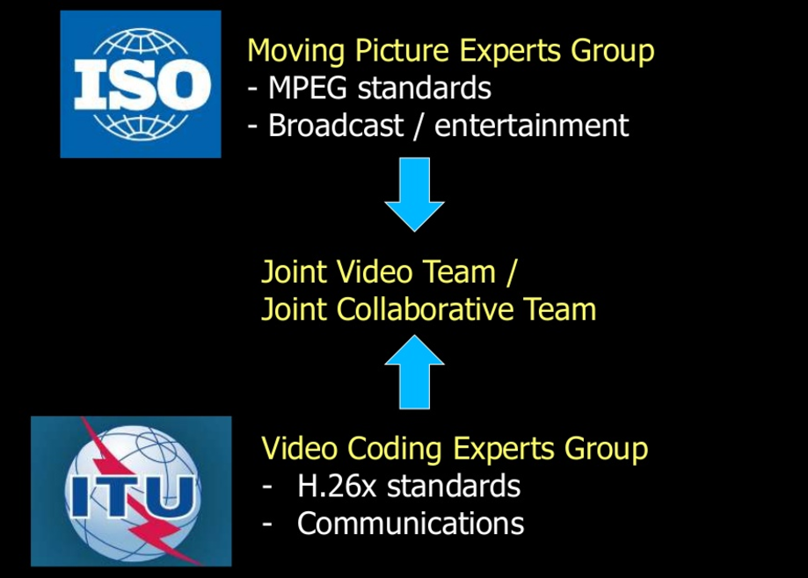


groups? ISO/IEC, ITU-R, JVT/JCT, AOM, MPEG-LA
Notes:
Off topic: but needed

Slide 45
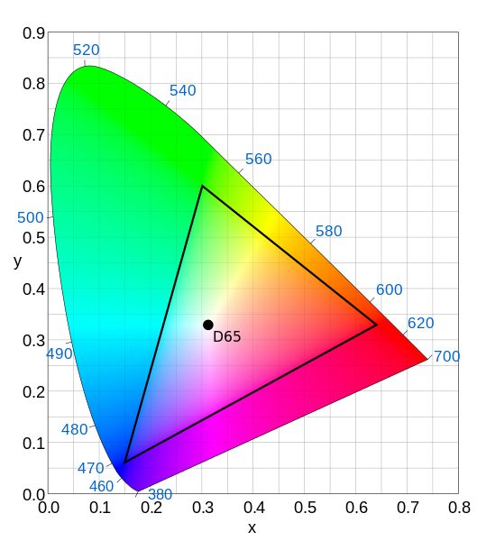
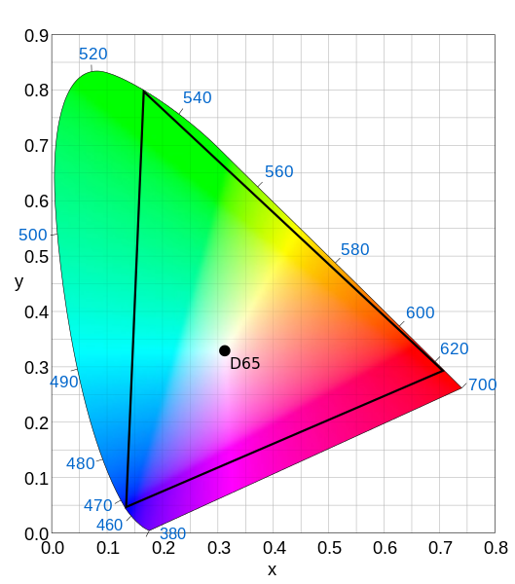
recommendations? Rec. 601, Rec. 709, Rec. 2020
Recommendation | Resolutions | Frame Rate | Bit Depth | Chroma Sub
BT.601 (SDTV) | 525i 625i | 50 60 | 8 | YCrCb 4:4:2
BT.709 (HDTV) | 1080p 1080i | 50 60 30 24 | 8 10 | * YCrCb 4:4:2
BT.2020 (UHDTV) | 7680p 3840p | 120, 100, 60, 50, 30, 24 | 10 12 | 4:4:4, 4:2:2, and 4:2:0
Rec. 601
Rec. 709
Rec. 2020
Notes:
Often people will talk with mnemonics BT REC…

Slide 46
Chroma subsampling YUV 4:4:4 4:2:2 4:2:0
Y (luma)
U (chroma blue)
V (chroma red)
Notes:
is the practice of encoding images by implementing less resolution for chroma information than for luma information, taking advantage of the human visual system's lower acuity for color differences than for luminance.
Luminance - perceived amount of energy

Slide 47
Chroma subsampling YUV 4:4:4 4:2:2 4:2:0
Y (luma)
U
V

Slide 48
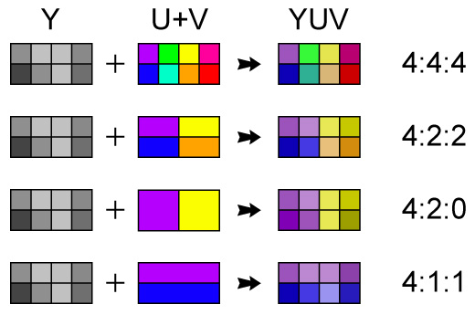
Chroma subsampling YUV 4:4:4 4:2:2 4:2:0

Slide 49
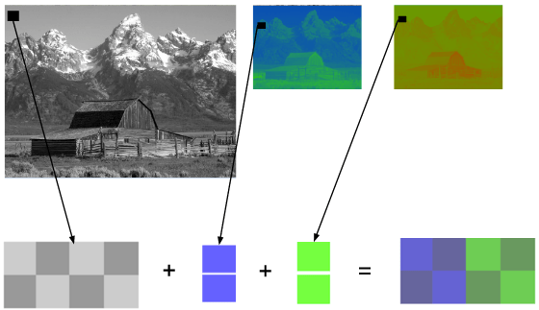
Chroma subsampling 4:2:0
Notes:
The merge process in detail, see that we spent only 8 + 2 + 2 with ycbcr

Slide 50
Chroma subsampling YUV420
320
1280
720
180
Notes:
Yuv420 is one of the most used chroma subsampling, it reduces a lot the other planes
PS: double check your camera, it might say it'll give you the highest quality but they're migtht be using 4:2:0 not 4:4:4

Slide 51
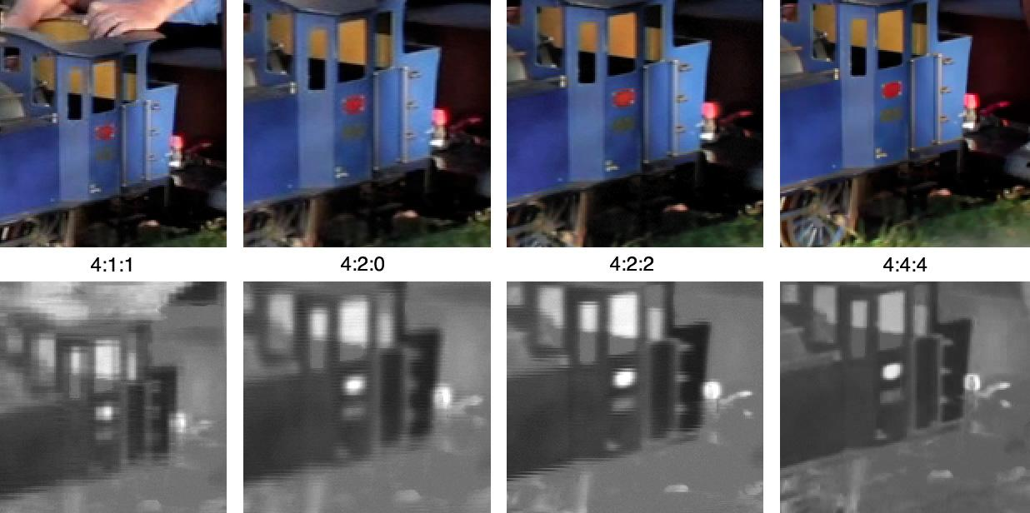
Chroma subsampling
Notes:
Up above are the image and their chroma subsampling and down bellow is the chroma resolution for the same image, you can easily spot that while looking at 4:4:4 and others
DEMO TIME http://www.red.com/learn/red-101/video-chroma-subsampling

Slide 52
Space needed to store 1h of video at 720p 30fps
WIDTH * HEIGHT * BITS_PER_PIXEL * FPS
1280 * 720 * 24 * 30
663,552,000 (663.552Mb) bits per second
2,388,787,200,000 (278GB)
with chroma subsampling YUV420
WIDTH * HEIGHT * BITS_PER_PIXEL * FPS
1280 * 720 * 12 * 30
331,776,000 (331.776Mb) bits per second
1,194,393,600,000 (139GB)
Notes:
DEMO TIME ./s/ffmpeg -i /files/v/small_bunny_1080p_30fps.mp4 -vf "split=2[a][b],[b]histogram,format=yuv420p[hh],[a][hh]overlay" /files/v/small_bunny_yuv_histogram.mp4
By exploiting our vision (or our deficiency to see color) we could cut in half the space needed to store the same video (great gain)
There is no way back to 4:4:4, I think you can move from 4:4:4 to 4:2:0 but not the other way around

Slide 53
Correlations in time

Slide 54
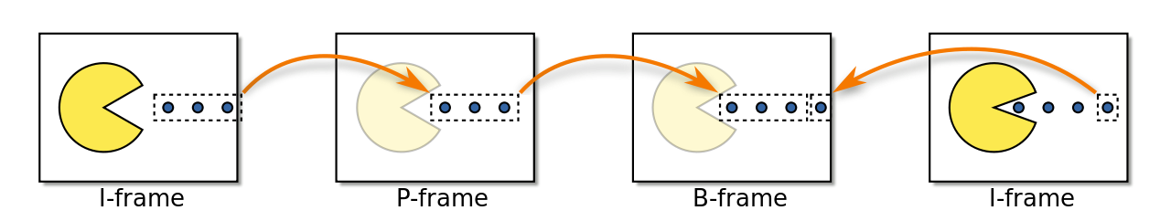
Frame types
Notes:
One way to tackle is to try some types of frames classification
An I‑frame is an 'Intra-coded picture', in effect a fully specified picture, like a conventional static image file. P‑frames and B‑frames hold only part of the image information, so they need less space to store than an I‑frame and thus improve video compression rates.
A P‑frame ('Predicted picture') holds only the changes in the image from the previous frame. For example, in a scene where a car moves across a stationary background, only the car's movements need to be encoded. The encoder does not need to store the unchanging background pixels in the P‑frame, thus saving space. P‑frames are also known as delta‑frames.
A B‑frame ('Bi-predictive picture') saves even more space by using differences between the current frame and both the preceding and following frames to specify its content.

Slide 55


Temporal redundancy (inter prediction)
original frames
F0
F1
F2
F3
F4
encoded frames
I-frame
P-frame
P-frame
P-frame
I-frame
Notes:
People notice that there was temporal redundancy in the frames, and they categorized types of frames, being P-frame holds only the changes in the image from the previous frame.
I‑frames are the least compressible but don't require other video frames to decode.
P‑frames can use data from previous frames to decompress and are more compressible than I‑frames.
B‑frames can use both previous and forward frames for data reference to get the highest amount of data compression.

Slide 56
Temporal redundancy
original frames
F0
F1
F2
F3
F4
|||||||||| (103Kb)
||| (2Kb)
||| (2Kb)
||| (2Kb)
|||||||||| (103Kb)
Notes:
It’ll save lots of space

Slide 57
Temporal redundancy with motion estimation
F0
F1
motion estimation (motion vector) applied to previous frame = predicted frame
predicted frame - real frame nth = residual (prediction error)
I-frame
P-frame
Notes:
After all
DEMO TIME https://github.com/leandromoreira/digital_video_introduction/blob/master/frame_difference_vs_motion_estimation_plus_residual.ipynb

Slide 58
Temporal redundancy (B frames)
original frames
F0
F1
F2
F3
F4
I-frame
P-frame
P-frame
B-frame
I-frame
Notes:
saves even more space by using differences between the current frame and both the preceding and following frames to specify its content.
DEMO time ./s/ffmpeg -flags2 +export_mvs -i /files/v/small_bunny_1080p_30fps.mp4 -vf codecview=mv=pf+bf+bb /files/v/small_bunny_1080p_30fps_vis_mv.mp4
IntelVideoProAnalyzer

Slide 59
Correlations in space

Slide 60
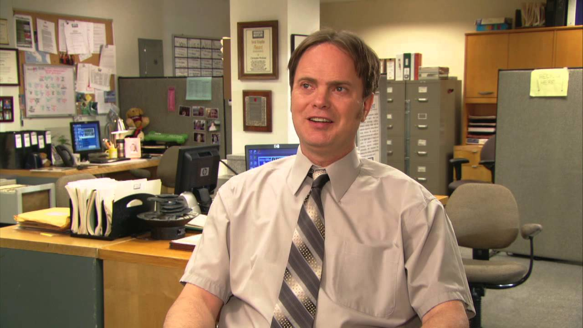
Lots of similarities
Notes:
Many areas with high correlation

Slide 61

Lots of similarities

Slide 62
Spatial redundancy (intra prediction)
100 | 100 | 100 | 200
100 | ??? | ??? | ???
100 | ??? | ??? | ???
100 | ??? | ??? | ???
100 | 100 | 100 | 200
100 | 100 | 100 | 200
100 | 100 | 100 | 200
100 | 100 | 100 | 200
100 | 100 | 100 | 200
100 | 100 | 100 | 200
100 | 100 | 100 | 200
100 | 100 | 120 | 210
100 | 100 | 100 | 200
100 | 0 | 0 | 0
100 | 0 | 0 | 0
100 | 0 | 20 | 10
unknown values
direction of the prediction
real values
difference
highly compressible
Notes:
exploits spatial redundancy, images tend to follow a pattern in colors

Slide 63
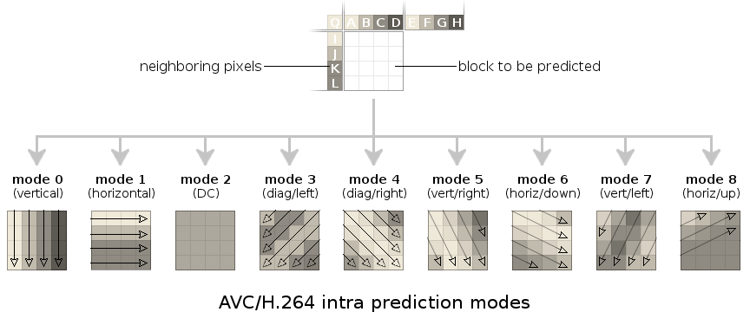
Spatial redundancy (intra prediction) H264
Notes:
DEMO TIME intelvideoproanalyzer

Slide 64
CODEC - enCOder / DECoder

Slide 65

CODEC
“A codec is a device or computer program for encoding or decoding a digital data stream or signal.”
Notes:
Standard H264 vs CODEC x264 (the best codec out there… yeah, people pay for the worst, we should be using ffmpeg, hardcore)
Standard defines: a syntax (bitstream) plus a decode process (in which many of the required patents go inside)

Slide 66
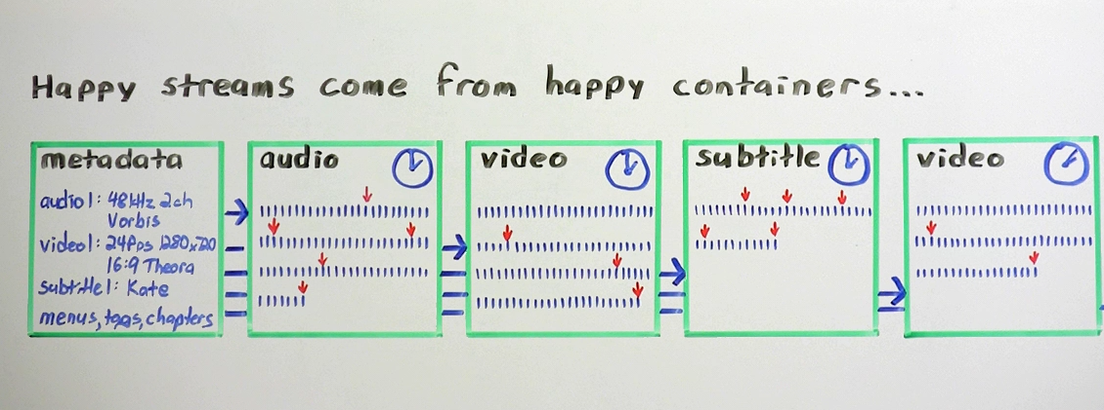
CODEC (VP9, H265) vs Container (.WEBM,.MP4)
Source https://xiph.org/video/vid1.shtml
Notes:
Container (A wrapper, utility to): metadata, framing, interleaving, timing, store and present the data.
Codec: the

Slide 67
Container vs CODEC
Containers
CODEC
OGG
MP4
WMA
AVI
MKV, WebM
TS
MOV
H264 / AVC
H265 / HEVC
MPEG-4
VP9
AV1
Theora
Daala

Slide 68
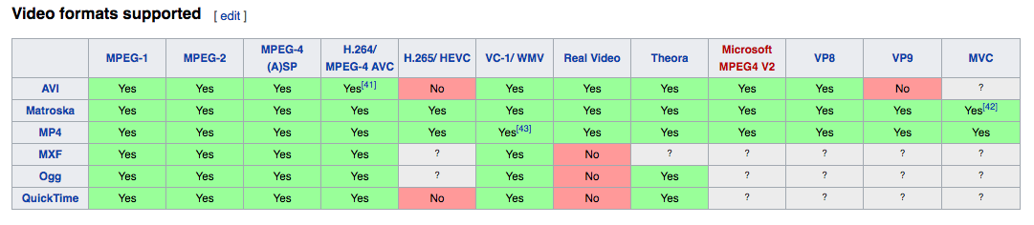

Slide 69
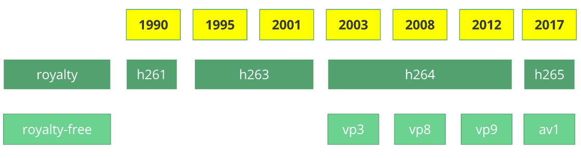
History
Notes:
Each of these codecs were created to solve a specific problem (like transport video 56kbps, telephone, videoconference), Internet bandwidth got larger, resolution got larger, cpu power got bigger…..

Slide 70
Patents all around
“Transform Coding of Image Diﬀerence Signals”
US patent 3679821, filed April 1970 and issued July 1972
“Motion vector estimation in television images”
US 4864393
“Block transform and quantization for image and video coding”
US 6882685
“Method and apparatus for binarization and arithmetic coding of a data value”
US 6900748
https://www.vcodex.com/video-compression-patents/
Notes:
DEMO TIME http://www.google.com/patents/US6882685

Slide 71
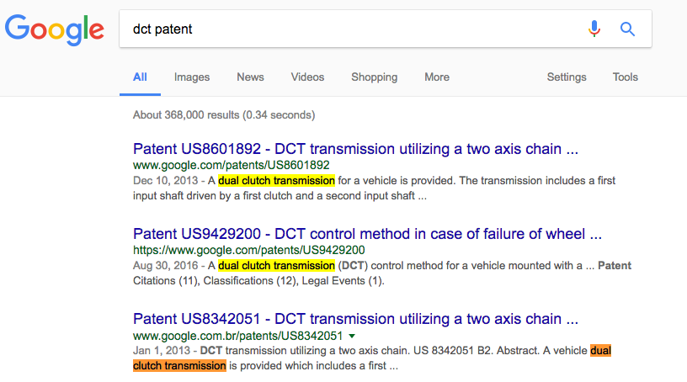
Patents all around (joke)

Slide 72
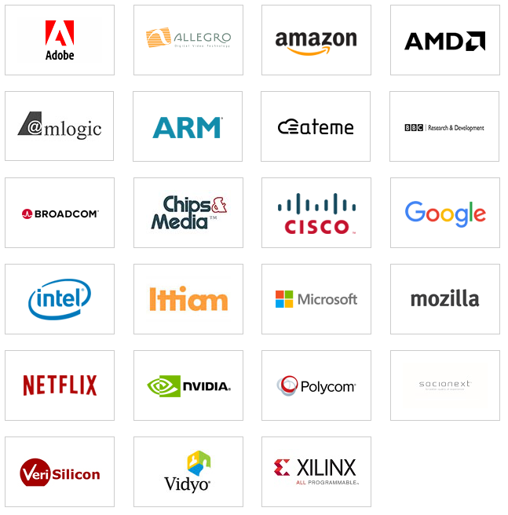
Alliance for Open Media - AV1
Daala
Thor
VP10
Notes:
H.265 licensing has historically been extremely expensive.
Microsoft would have had to pay hundreds of millions of dollars for H.265
HEVC Advance has changed the licensing policy, but it may be too late,
The Alliance for Open Media is founded by leading Internet companies focused on developing next-generation media formats, codecs and technologies.
Day one founding members are Amazon, Cisco, Google, Intel Corporation, Microsoft, Mozilla and Netflix.
Google Microsoft, Amazon, Netflix, Cisco, Mozilla and others are developing a royalty free alternative (under the name "Alliance for Open Media") so online video can never be held hostage again and since they hold browser and mobile.
Although they were formed in September 2015 only on April 5, 2016 they’ve announced the AV1 codec.

Slide 73
Alliance for Open Media - AV1
Interoperable and open;
Optimized for the Internet;
Scalable to any modern device at any bandwidth;
Designed with a low computational footprint and optimized for hardware;
Capable of consistent, highest-quality, real-time video delivery; and
Flexible for both commercial and non-commercial content, including user-generated content.
Notes:
The Alliance’s initial focus is to deliver a next-generation video format that is.
When will the codec ship? The group is aiming to freeze the bitstream sometime between the end of the 2016 and March 2017. Expect to see browser-based support soon thereafter, with the first hardware support within 12 months after that

Slide 74
Hybrid motion compensated CODEC
picture partitioning
predictions
transform
quantization
entropy coding
redundancy removal
entropy reduction
lossless compression
dct, dwt, intra-prediction, inter-prediction, motion estimation / compensation
linear, logarithm
huffman, lzw ...
Notes:
Almost all the codec works in a similar way and most recently the one based on motion compensated are even more related, so these blocks describes parts of how a codec works, probably we’ll show a real codec example during this explanation

Slide 75
CODEC
picture partitioning
predictions
transform
quantization
entropy coding
redundancy removal
entropy reduction
lossless compression
dct, dwt, intra-prediction, inter-prediction, motion estimation / compensation
linear, logarithm
huffman, lzw ...

Slide 76
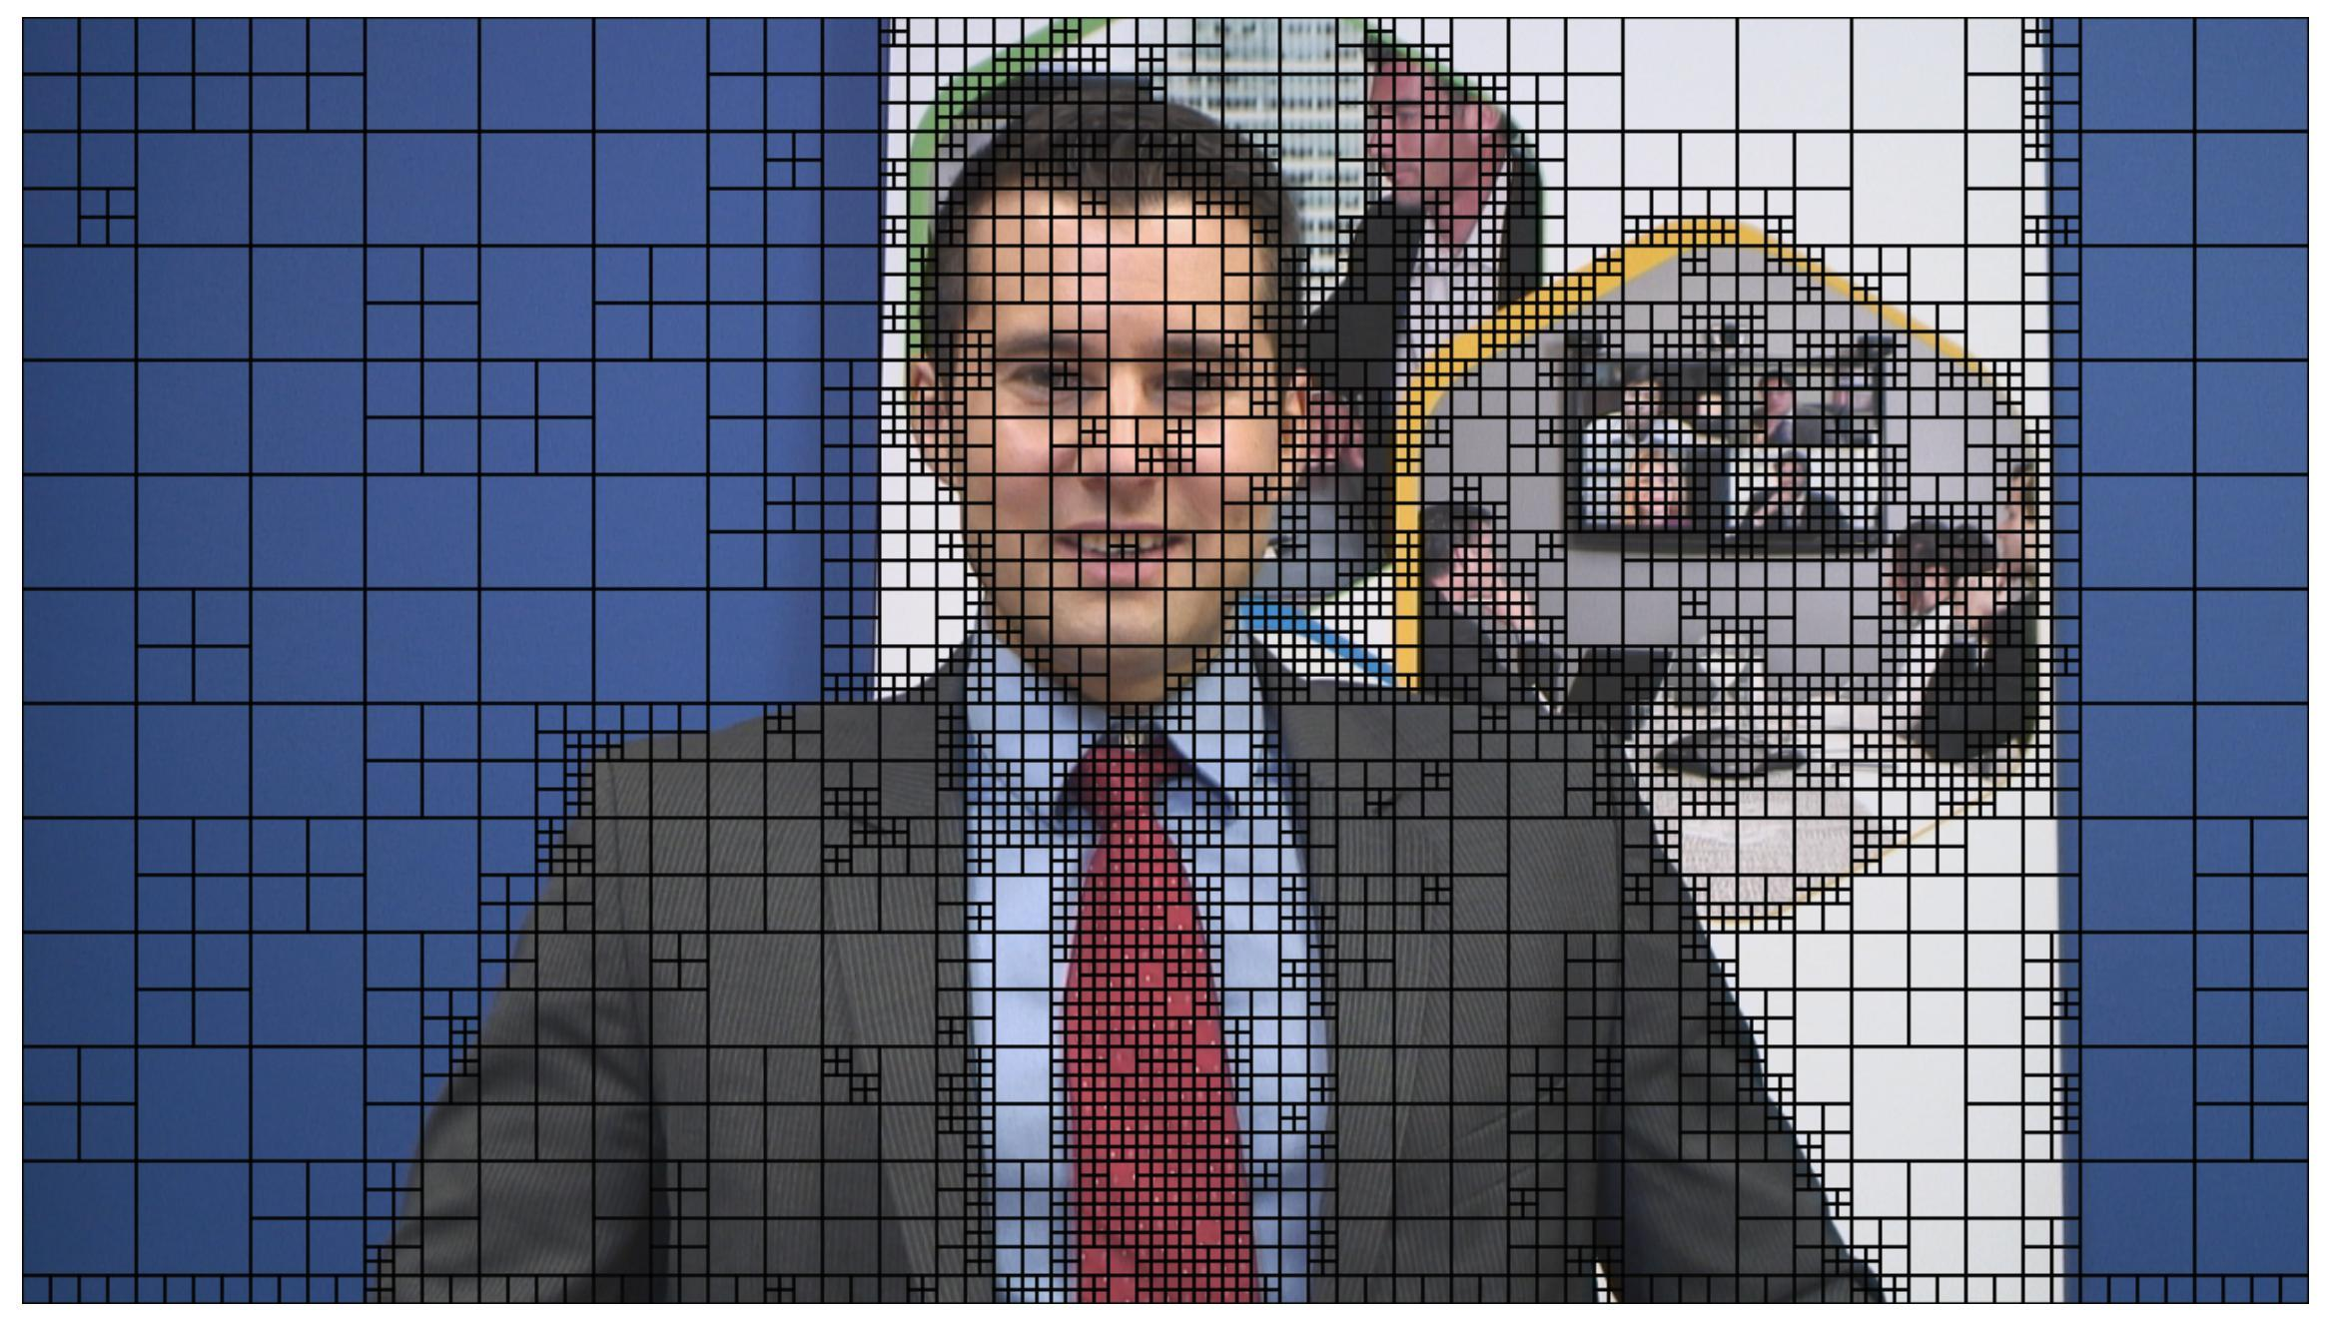
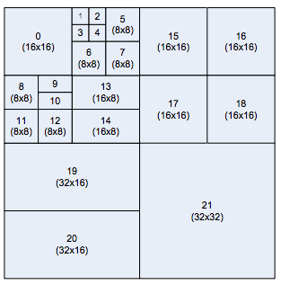
Frame partitioning
slices
Notes:
Partition the frame in blocks and the blocks in sub-blocks to take advantage of it, see that there is no recommendation about how to split blocks.
Variable block size allow variable predictions, the higher partitions, like slice and tiles, provides a way to parallelize encoding/decoding.
Picture partitioning - show ivpa

Slide 77
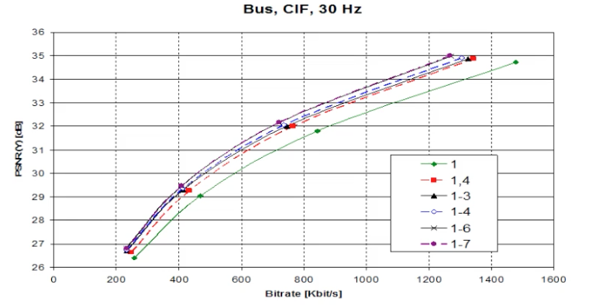
Fixed vs Variable block size
Notes:
DEMO TIME IntelVideoProAnalyzer

Slide 78
CODEC
picture partitioning
predictions
transform
quantization
entropy coding
redundancy removal
entropy reduction
lossless compression
dct, dwt, intra-prediction, inter-prediction, motion estimation / compensation
linear, logarithm
huffman, lzw ...

Slide 79
Motion estimation Inter|Intra-prediction
I-frame
P-frame
P-frame
B-frame
I-frame
100 | 100 | 100 | 200
100 | 100 | 100 | 200
100 | 100 | 100 | 200
100 | 100 | 100 | 200
direction of the prediction
Notes:
We talked about it in the beginning but be warned that the granularity is always macroblocks (sub blocks), slices as those shown before during the partitioning part

Slide 80
CODEC
picture partitioning
predictions
transform
quantization
entropy coding
redundancy removal
entropy reduction
lossless compression
dct, dwt, intra-prediction, inter-prediction, motion estimation / compensation
linear, logarithm
huffman, lzw ...

Slide 81
Transform
Double [3] f(x): x + x => [ 6]
Plus10 [3] f(x): x + 10 => [ 13]
Divide2 [3] f(x): x / 2 => [1.5]

Slide 82
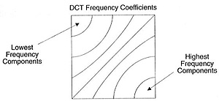
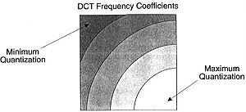
Transform (DCT)
Notes:
A transform is used to change pixels to something easier to compress.
The DCT (in the example) converts the blocks of pixels into same-sized blocks of frequency coefficients.
A 2D transform (usually the DCT) to eliminate spatial redundancy. It has energy compaction properties
It also compacts most of the energy from the original pixels into just a few coefficients, arranged such that reduced precision in the frequency domain is far less noticeable than reduced precision in the spatial domain.
Although it compacts things it’s reversible, aka you can come back to the original array.

Slide 83
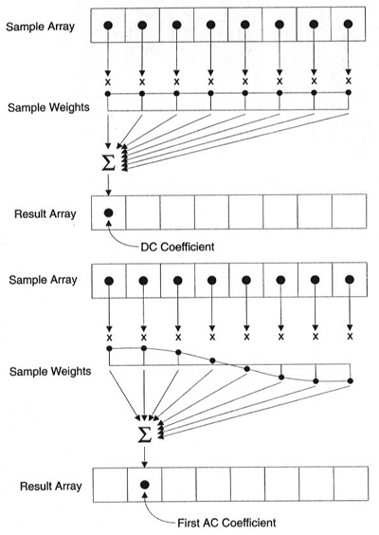
https://www.iem.thm.de/telekom-labor/zinke/mk/mpeg2beg/whatisit.htm
Notes:
The First coefficient (DC coefficient) represents of all the samples in the input array. The 63 (AC) coefficients represent color change across the block.
The frequency content of the sample set at each frequency is calculated by taking a weighted average of the entire set
These weight coefficients is like a cosine wave, whose frequency is proportional to the result array index.

Slide 84
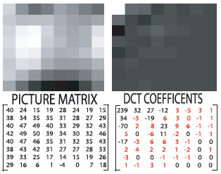
Transform (DCT[123], DWT, KLT, FFT, lapped…)
Notes:
DEMO https://github.com/leandromoreira/digital_video_introduction/blob/master/dct_experiences.ipynb
Most of the signal information tends to be concentrated in a few low-frequency components of the DCT.
H264 uses a very simple 8x8 4x4 transform only + / - approximation of a DCT but faster
FT complex numbers vs DCT real numbers [computationally faster] Convolution on spatial domain is multiplication on frequency domain
In the DCT the signal is decomposed into a sum of cosines, as opposed
to the Discrete Fourier transform (DFT) where the signal is decomposed
into a sum of sines and cosines.
To compress by DCT, keep the lower frequency and discard the “high frequencies”. We will keep the DCT coefficients that are within a certain distance from the upper left corner of a block, and set the remaining values to zero.
https://people.xiph.org/~xiphmont/demo/daala/demo1.shtml
Although it looks hard (show formula) it’s easier to implement than you think
Transform - show demo DCT (and gist)
https://gist.github.com/leandromoreira/9bb7b519173ba5158b5b4b213c46d8fa
I think the genius is to come up with it.

Slide 85
CODEC
picture partitioning
predictions
transform
quantization
entropy coding
redundancy removal
entropy reduction
lossless compression
dct, dwt, intra-prediction, inter-prediction, motion estimation / compensation
linear, logarithm
huffman, lzw ...

Slide 86
Quantization over DCT (uniform, linear, logarithm)
120 | 40 | 1 | 0
45 | 3 | 0 | 0
-5 | 0 | 0 | 1
0 | 0 | -2 | 0
12 | 4 | 0 | 0
4 | 0 | 0 | 0
0 | 0 | 0 | 0
0 | 0 | 0 | 0
Qstep (10)
12 | 4 | 0 | 0
5 | 0 | 0 | 0
0 | 0 | 0 | 0
0 | 0 | 0 | 0
120 | 40 | 0 | 0
40 | 0 | 0 | 0
0 | 0 | 0 | 0
0 | 0 | 0 | 0
Qstep (10)
Notes:
DEMO https://github.com/leandromoreira/digital_video_introduction/blob/master/uniform_quantization_experience.ipynb
Playing with quantization value
DEMO 2 https://www.hdm-stuttgart.de/~maucher/Python/MMCodecs/html/jpegUpToQuant.html
This is the part where you losses precision/data, here is the part that tweaked when you’re configuring the bit rate.
The example here it’s a simple uniform quantization, usually there are matrices or functions to do that better (with context)
JPEG uses a defined table and then it provides QF (quantization factor) that multiply the known matrices

Slide 87
CODEC
picture partitioning
predictions
transform
quantization
entropy coding
redundancy removal
entropy reduction
lossless compression
dct, dwt, intra-prediction, inter-prediction, motion estimation / compensation
linear, logarithm
huffman, lzw ...

Slide 88
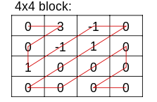
Entropy coding quantized DCT
zig-zag scan
(2D to 1D)
lossless compress
coded block
000010001110
010111101101
frequent symbols table
-1,1
trailing zeroes
...
*CAVLC example
Notes:
Last but not least, you’ll compress that quantized DCT transformed to a 1D to a lossless compression.
entropy - data is compressed mostly because is correlated VLC or Arithmetic

Slide 89
CODEC
picture partitioning
predictions
transform
quantization
entropy coding
redundancy removal
entropy reduction
lossless compression
dct, dwt, intra-prediction, inter-prediction, motion estimation / compensation
linear, logarithm
huffman, lzw ...
Notes:
After all work we can “encode” the final compressed image in a known format, usually called bitstream
Hybrid motion compensation - show gist and walk through it

Slide 90
Space needed to store 1h of video at 720p 30fps
with chroma subsampling YUV420
WIDTH * HEIGHT * BITS_PER_PIXEL * FPS
1280 * 720 * 12 * 30
331,776,000 (331.776Mb) bits per second
1,194,393,600,000 (139GB)
with H264 (chroma subsampling, motion estimation, intra prediction, CABAC…)
WIDTH * HEIGHT * BITS_PER_PIXEL * FPS
1280 * 720 * 0.031 * 30
857,088 (837Kb) bits per second
3,085,516,800 (367.82MB)

Slide 91
CODEC and patents
picture partitioning
predictions
transform
quantization
entropy coding
US 4864393
US 6882685
* US 6900748
*it seems to be expired by 2000s
Notes:
“Transform Coding of Image Diﬀerence Signals” US patent 3679821, filed April 1970 and issued July 1972
“Motion vector estimation in television images” US 4864393
“Block transform and quantization for image and video coding” US 6882685
“Method and apparatus for binarization and arithmetic coding of a data value” US 6900748

Slide 92
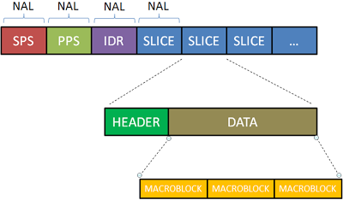
Bitstream format
Notes:
Network Abstract Layer: First 1 byte for H264, 2 bytes H265 is the type, the rest is the payload.
NAL can be categorized as VCL (video coding layer) and non-VCL. NAL was created to serve to store, transmit everywhere (Internet, satellite and etc.)
NAL can be packet-oriented or bitstream-oriented.
In the byte stream format, each NAL unit is prefixed by a specific pattern of three bytes called a start code prefix.
In the packet-oriented, the coded data is carried in packets that are framed by the system transport protocol, without the start code prefix.
The parameters are also sent as NAL (SPS, PPS):
SPS - apply to a series of consecutive coded video pictures, (such as Entropy code, resolution…)
PPS: apply to the decoding of one or more individual pictures
Each VCL NAL unit contains an identifier that refers to the content of the relevant PPS and each PPS contains an identifier that refers to the content of the relevant SPS.

Slide 93

Bitstream format
Notes:
DEMO TIME IntelVideoProAnalyzer
Here we can see more the things we talked about it, like the YCbCR, Motion Vectors (from the predictions), Modes(intra, Inter...). Keep in mind that this bitstream format example is from h264.

Slide 94


Hybrid motion compensated encoding
Notes:
Review the encoding part, showing where is fixed by the standard and the other parts where is a task for the encoders makers (you can compare different encoders and see how they perform, this is a task I think you should do.)
The yellow/green blocks is where a encoder can be better than the other even if it produces the same final bitstream.
Preprocessor (filter, frame partitioning is by encoder decision, this makes one more efficient than other)
You can notice how you can rate control by affecting the quantization and bitstream encoder (bitrate)
All this in less than 1000/FPS ms
Later we’ll talk a little bit about bit stream
https://tools.ietf.org/html/draft-fuldseth-netvc-thor-03

Slide 95

Hybrid motion compensated decoding
Notes:
The decoder should be the inverse of the process
https://gist.github.com/leandromoreira/b89918be6f13e7c5452fa1b6b5a8eede

Slide 96
H264 vs H265
Notes:
Similar but

Slide 97

AVC @ 4Mbps
HEVC @ 2Mbps

Slide 98
AVC @ 400kbps
HEVC @ 400kbps

Slide 99

Notes:
H265 takes advantage of more powerful CPUs and it also brings things like: larger partitions, and more adaptable partitions (which makes it work even better or higher resolutions), it also counts with 35 intra prediction directions, it only supports progressive, CABAC… and the entropy coding too was advanced, they work in each area in order to bring the rule of thumb 50% better than last CODEC
H265 also introduced tiles as another way to partitioning frames, it enables parallel computation.
But on the other hand it is even expensive than h264 (royalt wise speaking) and the companies Microsoft, google, netflix, mozilla and other are going to AOM (AV1) and skipping h265 or webm vp9, which works in most browser.
H264 vs H265 - show ivpa with both codecs
HEVC replaces macroblocks, which were used with previous video standards, with CTUs which can use larger block structures of up to 64×64

Slide 100
Video streaming

Slide 101

General Video Delivery Architecture
ingest
encoder
CDN (frontend, caching)
origin

Slide 102
Content distribution

Slide 103
Progressive download
Range: bytes=0-299
full_video.mp4
HTTP 206
Range: bytes=300-499
time
HTTP 206
Range: bytes=500-999
HTTP 206

Slide 104
Adaptive bitrate streaming
2G
manifest
HTTP 200
2G
s480p_01.mp4
HTTP 200
time
wifi
s480p_02.mp4
HTTP 200
wifi
s1080p_03.mp4
HTTP 200

Slide 105

Adaptive bitrate streaming (hls)
source: https://www.encoding.com/http-live-streaming-hls/

Slide 106
Content protection

Slide 107
Token + CORS + TLS (https)
video=3
CDN
HTTP 403
video=3& cookie
API
time
token=CAFE
video=3&t=CAFE
CDN
HTTP 200
Notes:
For sure, https, Cross-origin resource sharing

Slide 108
DRM (widevine, playready, fairplay)
new_video.mp4
encoding
DRM servers Apple, M$, Google
dash_encrypted_new_video.mp4
CDN

Slide 109
Encoding parameters: the whys

Slide 110
CBR vs VBR
LIVE: CBR, the biggest problem is bandwidth, VBR might cause lots of rebufferings, latency is critical, small hiccups are acceptable.
VOD progressive download: “Constrained” VBR - min 50% of TARGET max 200%.
VOD adaptive streaming: “Constrained” VBR - min 85-100% of TARGET max 125-150%
Notes:
By using VBR, segments of video with the same bitrate will be quite different in terms of size, confusing the ABR algorithm on the player. Since live is very sensitive to fluctuations in connection, we usually want to use CBR.
CBR vs VBR - show ffmpeg command

Slide 111

Notes:
You’ll notice that if you chose a given profile you won’t have access to improvements.
Profiles - check elemental

Slide 112

Profiles for iOS-like >= High 3.1
https://developer.apple.com/library/content/technotes/tn2224/_index.html
Notes:
Pause to look around the recommended config

Slide 113

Profiles for Android-like >= High 3.1
Notes:
API should return right codec for “100%” but it’s expensive to keep caching of all this

Slide 114
Frame types and GOP
P and B are lighter but they require search for frames back or forward.
Adjust keyframe (I) interval insertion to 2,3,4 or 5 seconds, otherwise in VBR you’re just wasting resources
Adjust your keyframes considering your chunk size, it should be a multiple of it. Ex: chunk of 6s therefore I-Frame each 1s or 2s
Turn off ‘keyframe scene detection”
Yes to B frame, “magic number” between 3-4
Notes:
Why live doesn’t show too much of difference when you coded it with 1 or 4s I-frame? Because it uses CBR

Slide 115

B-Frame magic

Slide 116
Bits per pixel
What is the resolution for 2.5Mbps?
Let’s try:
Height: 393, Width: 720 Pixels: 282960 Bitrate: 2500 FPS: 30
BitsPerPixel: Bitrate/(Pixels*FPS)
1500/282960*30 = 0.2650551315
Notes:
Bits per pixel - tell about how larger is smaller it’ll be (a good measure to look competitors)

Slide 117
lossless compression - entropy encoding
CABAC - more efficient, CPU intensive (battery and so on) [main, high profile]
CAVLC - less efficient, CPU less intensive
Notes:
CABAC offers 10-15% improved compression on live-action
CABAC is not allowed in Baseline Profile.

Slide 118

Apple TN2224
Notes:
The apple changed its opinion about audio bitrate (now, I think we should always tries new things to see what happens)

Slide 119
Bonus: audio codec

Slide 120

Analog audio conversion

Slide 121


Sampling (8,11, 32, 44.1, 48, 50, 88, 96, 192... kHz)
Notes:
Convert the continuous signal to discrete. The quantity of samples you’ll get for second (Hz)
https://github.com/leandromoreira/encoding101#audio-sampling

Slide 122

Bit depth (16, 24, 32, 64... bits) quantization
Notes:
The resolution of the frequencies (what’s the highest point).
8: 0x00-0xFF (255)
https://github.com/leandromoreira/encoding101#audio-bit-depth

Slide 123

Channels 2
Notes:
You can simulate our ear by using two devices to capture the sound.

Slide 124

Channels 16.2

Slide 125

PCM encoder

Slide 126

AAC CODEC block

Slide 127
References

Slide 128
Links
https://www.coursera.org/learn/digital/
http://www.cambridgeincolour.com/tutorials/camera-sensors.htm
https://en.wikipedia.org/wiki/Intra-frame_coding
https://en.wikipedia.org/wiki/Inter_frame
http://stackoverflow.com/questions/38094302/how-to-understand-header-of-h264
http://gentlelogic.blogspot.com.br/2011/11/exploring-h264-part-2-h264-bitstream.html
https://trac.ffmpeg.org/wiki/Encode/H.264
http://www.itu.int/ITU-T/recommendations/rec.aspx?rec=12904&lang=en

Slide 129
Links
https://cardinalpeak.com/blog/worlds-smallest-h-264-encoder/
https://cardinalpeak.com/blog/the-h-264-sequence-parameter-set/
https://codesequoia.wordpress.com/category/video/
https://ffmpeg.org/ffprobe.html
https://en.wikipedia.org/wiki/Presentation_timestamp
https://www.linkedin.com/pulse/video-streaming-methodology-reema-majumdar
https://leandromoreira.com.br/2016/10/09/how-to-measure-video-quality-perception/
https://www.linkedin.com/pulse/brief-history-video-codecs-yoav-nativ

Slide 130
Links
http://www.slideshare.net/vcodex/a-short-history-of-video-coding
http://www.slideshare.net/vcodex/introduction-to-video-compression-13394338
https://www.lifewire.com/cmos-image-sensor-493271
https://www.youtube.com/watch?v=9vgtJJ2wwMA
https://developer.android.com/guide/topics/media/media-formats.html
https://www.encoding.com/android/
http://www.nintendo.com/switch/
https://developer.apple.com/library/content/technotes/tn2224/_index.html
http://www.lighterra.com/papers/videoencodingh264/

Slide 131
Links
http://www.slideshare.net/ManoharKuse/hevc-intra-coding
http://www.slideshare.net/mwalendo/h264vs-hevc
http://www.slideshare.net/rvarun7777/final-seminar-46117193
http://x265.org/hevc-h265/
http://www.compression.ru/video/codec_comparison/h264_2012/mpeg4_avc_h264_video_codecs_comparison.pdf
http://vanseodesign.com/web-design/color-luminance/
https://storage.googleapis.com/downloads.webmproject.org/docs/vp9/vp9-bitstream-specification-v0.6-20160331-draft.pdf
https://en.wikipedia.org/wiki/AOMedia_Video_1

Slide 132
Links
http://www.hkvstar.com
http://www.hometheatersound.com/
https://www.vcodex.com/h264avc-intra-precition/
http://bbb3d.renderfarming.net/download.html
http://www.slideshare.net/vcodex/a-short-history-of-video-coding
https://www.encoding.com/http-live-streaming-hls/
https://en.wikipedia.org/wiki/Adaptive_bitrate_streaming
http://www.adobe.com/devnet/adobe-media-server/articles/h264_encoding.html

Slide 133
Links
https://www.youtube.com/watch?v=Lto-ajuqW3w&list=PLzH6n4zXuckpKAj1_88VS-8Z6yn9zX_P6
https://www.youtube.com/watch?v=LFXN9PiOGtY
https://github.com/leandromoreira/encoding101
https://people.xiph.org/~jm/daala/revisiting/
https://cardinalpeak.com/blog/the-h-264-sequence-parameter-set/
https://cardinalpeak.com/blog/worlds-smallest-h-264-encoder/
https://people.xiph.org/~tterribe/pubs/lca2012/auckland/intro_to_video1.pdf
https://tools.ietf.org/html/draft-fuldseth-netvc-thor-03
https://prezi.com/8m7thtvl4ywr/mp3-and-aac-explained/

Slide 134
Links
http://www.slideshare.net/MadhawaKasun/audio-compression-23398426
http://techblog.netflix.com/2016/08/a-large-scale-comparison-of-x264-x265.html
http://yumichan.net/video-processing/video-compression/introduction-to-h264-nal-unit/
http://www.springer.com/cda/content/document/cda_downloaddocument/9783642147029-c1.pdf
http://iphome.hhi.de/wiegand/assets/pdfs/2012_12_IEEE-HEVC-Overview.pdf
http://www.red.com/learn/red-101/video-chroma-subsampling

Slide 135
Links
http://www.streamingmedia.com/Articles/Editorial/Featured-Articles/A-Progress-Report-The-Alliance-for-Open-Media-and-the-AV1-Codec-110383.aspx
http://www.explainthatstuff.com/digitalcameras.html
https://www.youtube.com/watch?v=LWxu4rkZBLw
http://www.csc.villanova.edu/~rschumey/csc4800/dct.html
http://stackoverflow.com/a/24890903
https://xiph.org/video/vid1.shtml
https://xiph.org/video/vid2.shtml
http://web.ece.ucdavis.edu/cerl/ReliableJPEG/Cung/jpeg.html
https://en.wikipedia.org/wiki/Pixel_aspect_ratio
https://www.coursera.org/learn/digital/

Slide 136
Links
http://bugra.github.io/work/notes/2014-07-12/discre-fourier-cosine-transform-dft-dct-image-compression/
https://www.hdm-stuttgart.de/~maucher/Python/MMCodecs/html/jpegUpToQuant.html
https://www.iem.thm.de/telekom-labor/zinke/mk/mpeg2beg/whatisit.htm

